Slide 1
CS5560 Knowledge Discovery and Management
Lecture 3: Information Extraction – OpenIE, WordNet, ConceptNet
References:
Daniel Weld, Open Information Extraction
Prof. Yates’s Text Mining and Language Processing
Christiane Fellbaum, WordNet
Hugo Liu, Push Singh, Commonsense Reasoning in and over Natural Language
Marti A. Hearst, Text Data Mining: Issues, Techniques, and the Relation to Information Access
Erk, Katrin. "A simple, similarity-based model for selectional preferences.“ ANNUAL MEETING-ASSOCIATION FOR COMPUTATIONAL LINGUISTICS. Vol. 45. No. 1. 2007.

Slide 2
What is in the Text Analysis Arena?
Knowledge Rep. &
Reasoning / Tagging
Search & DB
Semantic Web
Web2.0
Information
Retrieval
Computational
Linguistics
Text Analytics
Data Analysis
Natural Language
Processing
Machine Learning
Text Mining

Slide 3
Information Extraction
Definition:
The automatic extraction of structured information from unstructured documents.
Overall Goals:
Making information more accessible to people
Making information more machine-processable
Practical Goal: Build large knowledge bases

Slide 4
Information Extraction Projects (demo)
TextRunner (Open Information Extraction)
http://openie.cs.washington.edu/
YAGO
https://www.mpi-inf.mpg.de/departments/databases-and-information-systems/research/yago-naga/yago/demo/
ConceptNet 5
http://conceptnet5.media.mit.edu/web/c/en/demo

Slide 5
Information Extraction vs. Information Retrieval
Information Retrieval (IR) and Text Mining
Make document-level judgments
Rank documents for a query
Assign a label to a document
Information Extraction (IE)
Make phrases-level judgments
Start looking more closely at the text within a document.
Identify a few nuggets of interesting text, and pull them out.

Slide 6
Information Extraction vs. Natural Language Processing
IE is the task of automatically extracting structured information from unstructured and/or semi-structured machine-readable documents. In most of the cases this activity concerns processing human language texts by means of NLP (e.g., Vocabulary analysis, Named entity recognition, Coreference, Relationship extraction)
Typical NLP problems
Paraphrase – many ways to say the same thing
Ambiguity – the same word/phrase/sentence may mean different things in different contexts
IE-specific problems: data integration
Representation: what counts as a relationship? an entity?
Large-scale entity and relation resolution

Slide 7
Information Extraction: Traditional Approach
Systems find instances of target relations.
e.g., HeadquarteredIn(<company>, <city>)
Some newswire text:
EMI Music Publishing Latin America, the Latin music and entertainment arm of the EMI music conglomerate, has its headquarters in Miami, FL.
HeadquarteredIn(EMI, Miami)

Slide 8
Information Extraction in Applications
Structured Search
Opinion Mining/Sentiment Extraction
Data Mining over Extracted Relationships

Slide 9
IE: Structured Search
Search today is primarily “keyword search”.
e.g., a search for “EMI headquarters”
But what if you want to know something that’s not listed on any one page, but is spread out over many pages?
“What music companies are headquartered in major cities in the Southeastern US?”
“How many schools in PA closed two or more times because of snow?”
“What are some high-paying job offers for computer science PhDs?”
Probably no single document mentions all these.
Many different documents mention parts of the answer.
If we extracted all these relationships into a database, running this query is trivial.

Slide 10
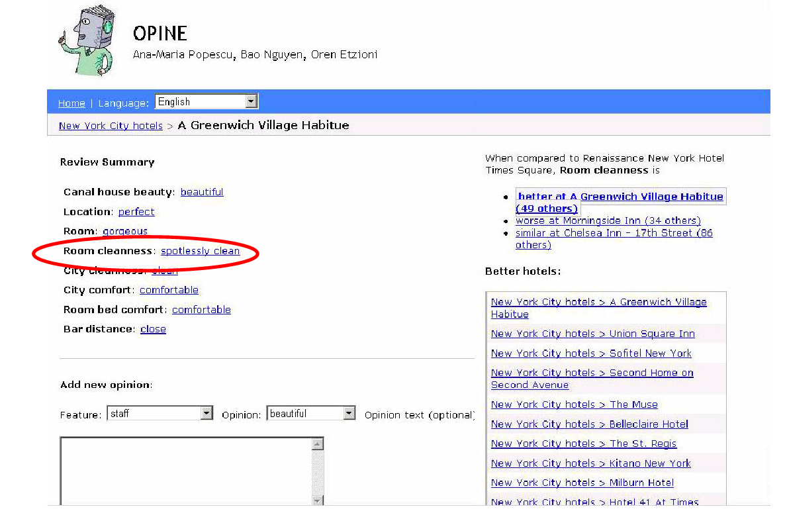
IE: Opinion Mining

Slide 11
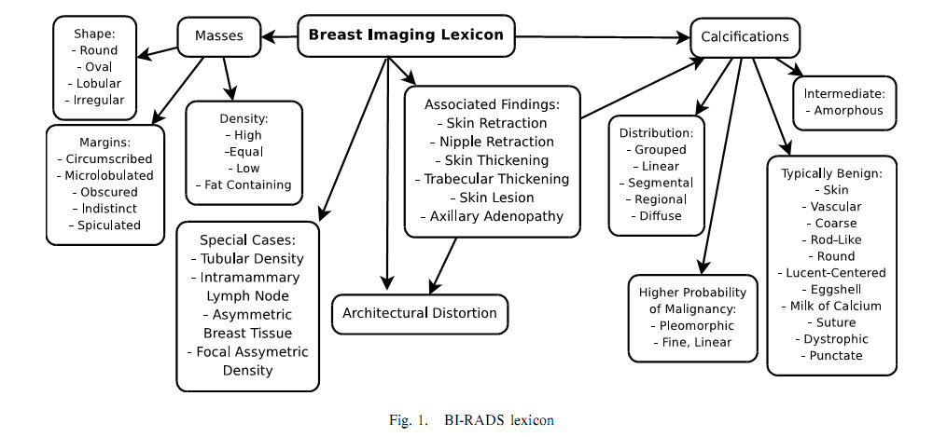
Data Mining on Extracted Relations
Researchers have built classifiers for predicting breast cancer based on databases of doctors’ and nurses’ reports.
However, the reports often have incomplete fields, and many fields are raw text.
Information extraction can fill in the missing fields from the text, to support the classifiers.

Slide 12
IE: Entity Resolution
How many distinct “Al Gore” entities are there on the Web?
One of those entities served as the 45th Vice President of the United States
Is that the same one who is the inventor of the Internet, or a different one? How do you know?
http://www.washingtonpost.com/blogs/fact-checker/wp/2013/11/04/a-cautionary-tale-for-politicians-al-gore-and-the-invention-of-the-internet

Slide 13
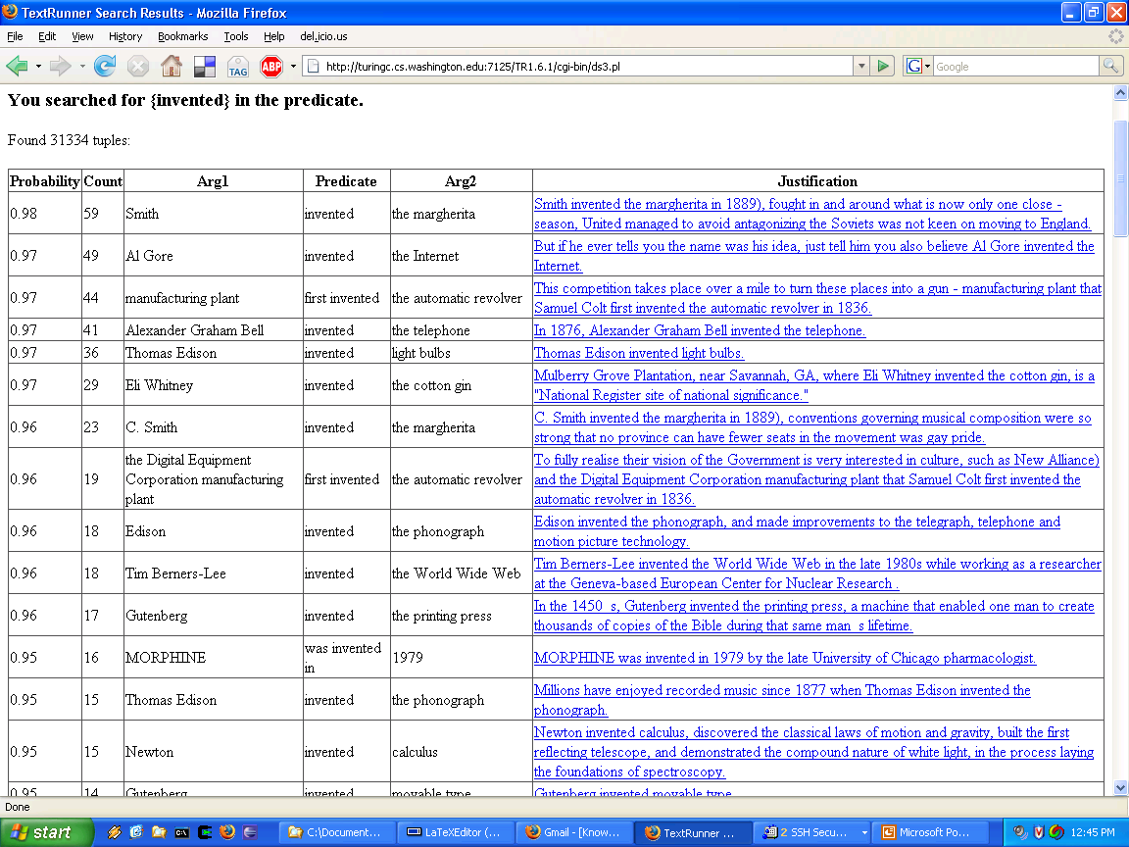
http://www.cs.washington.edu/research/textrunner/

Slide 14
Smith
invented
the margherita
Alexander Graham Bell
invented
the telephone
Thomas Edison
invented
light bulbs
Eli Whitney
invented
the cotton gin
Edison
invented
the phonograph
http://www.cs.washington.edu/research/textrunner/

Slide 15
Al Gore
invented
the Internet
http://www.cs.washington.edu/research/textrunner/

Slide 16
Smith
invented
the margherita
C. Smith
invented
the margherita
http://www.cs.washington.edu/research/textrunner/

Slide 17
Thomas Edison
invented
light bulbs
Edison
invented
the phonograph
http://www.cs.washington.edu/research/textrunner/

Slide 18
Representations for IE
Relation Resolution
Raised(fire truck, ladder) ⬄ Lifted(fire truck, ladder)
Lifted(UN, sanctions) ⬄ Removed(UN, sanctions)
Raised(Walmart, prices) ⬄? Removed(Walmart, prices)
What set of relationships exist in the world?
Extremely old problem in philosophy; no good answer.
Which set of relations should we try to extract examples of?

Slide 19
Open Information Extraction on the Web
TextRunner Banko et al., IJCAI’07
Unsupervised, single-pass extraction for the Web.
No relation names required for input.
Extracted
Tuple:
was founded by (EBay, Pierre Omidyar )
Noun
Relation
Noun Phrase
EBay was founded by Pierre Omidyar.

Slide 20
IE Techniques
Manually constructed patterns
Pattern-learning and bootstrapping
Supervised Classifiers

Slide 21
Manually-Constructed IE Patterns
Pattern: A:physical-object was bombed by B
➔ exists C . terrorist-attack(C)
^ perpetrator(C, B)
^ target(C, A)
“The parliament building was bombed by guerrillas.”
perpetrator(C, guerrillas)
and target(C, parliament building)

Slide 22
Rule (Pattern) Learning
How to design patterns for some new relationship?
E.g., enzymes and the molecular pathway(s) they’re involved in?
Cities and their mayors? Films and their directors?
Can we automate the process of identifying patterns?
Rule learning automates this process, if it is given some examples of the relationship of interest.
For instance, some example enzyme names and the names of the pathways they’re involved in.
Bootstrapping is a searching technique to perform an inexact search (e.g., keywords) and retrieve numerous "hits", some of which will be on-target.

Slide 23
Bootstrapping
Rule Learning
Seed Examples
Philadelphia – Michael Nutter
New York – Michael Bloomberg
Extraction Rules
X is mayor of Y
X, mayor of Y
X runs City Hall in Y
High-confidence
Extractions

Slide 24
Bootstrapping
Rule Learning
Seed Examples
Philadelphia – Michael Nutter
New York – Michael Bloomberg
San Diego – Jerry Sanders
Belgrade -- Dragan Đilas
Extraction Rules
X is mayor of Y
X, mayor of Y
X runs City Hall in Y
Social Democrat X is new mayor of Y
High-confidence
Extractions

Slide 25
Example Text Mining Applications
News topic classification (e.g., Google News)
C={politics, sports, business, health, tech,…}
“Safe Search” filtering
C={appropriate, not appropriate}
Language classification
C={English, Spanish, Chinese,…}
Sentiment classification
C={positive review, negative review}
Email sorting
C={spam, meeting reminders, invitations, …}

Slide 26
Spam or not Spam?
Most people who’ve ever used email have developed a hatred of spam
In the days before Gmail (and still today), you could get hundreds of spam messages per day.
“Spam Filters” were developed to automatically classify, with high (but not perfect) accuracy, which messages are spam and which aren’t.

Slide 27
Text Mining Example: Spam or not Spam?
Let C = {“Spam”, “Not Spam”} or {S,N}
Let H be the set of conjunctive rules, like:
“if document d contains
‘free credit score’ AND
‘click here’
→ Spam”

Slide 28
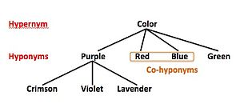
Word Level: Properties
The most common representation of text used for many techniques
Relations among word surface forms and their senses:
Homonomy: same form, but different meaning (e.g. bank: river bank, financial institution)
Polysemy: same form, related meaning (e.g. bank: blood bank, financial institution)
Synonymy: different form, same meaning (e.g. singer, vocalist)
Hypernymy (super/sub-concept)
Hyponymy (sub/super-concept)
one word denotes a super/subclass of an another (e.g. meal, breakfast)
Word frequencies in texts have power distribution:
…small number of very frequent words
…big number of low frequency words

Slide 29
WordNet: Database of Lexical Relations
WordNet is the most well developed and widely used lexical database for English
…it consist from 4 databases (nouns, verbs, adjectives, and adverbs)
Thesaurus has a main function to connect different surface word forms with the same meaning into one sense (synonyms) e.g.:
musician, instrumentalist, player
person, individual, someone
life form, organism, being
…additionally we often use hypernym relation to relate general-to-specific word senses
…by using synonyms and hypernym relation we compact the feature vectors
Category | Unique Forms | Number of Senses
Noun | 94474 | 116317
Verb | 10319 | 22066
Adjective | 20170 | 29881
Adverb | 4546 | 5677

Slide 30
WordNet Relations
Each WordNet entry is connected with other entries in the graph through relations
Relations in the database of nouns:
Relation | Definition | Example
Hypernym | From lower to higher concepts | breakfast -> meal
Hyponym | From concepts to subordinates | meal -> lunch
Has-Member | From groups to their members | faculty -> professor
Member-Of | From members to their groups | copilot -> crew
Has-Part | From wholes to parts | table -> leg
Part-Of | From parts to wholes | course -> meal
Antonym | Opposites | leader -> follower

Slide 31
WordNet – excerpt from the graph
sense
relation
sense
26 relations
116k senses

Slide 32
What is ConceptNet?
The largest freely available, machine-useable commonsense resource.
Structured as a network of semi-structured natural language fragments.
mined out of the Open Mind Commonsense (OMCS) corpus.
A collection of nearly 700,000 semi-structured English sentences of commonsense facts.
An automatic process which applies a set of ‘commonsense extraction rules’.
A pattern matching parser uses roughly 40 mapping rules.
Consists of over 250,000 elements of commonsense knowledge.
Inspired dually by the range of commonsense concepts and relations in Cyc, and by the ease-of-use of WordNet.

Slide 33
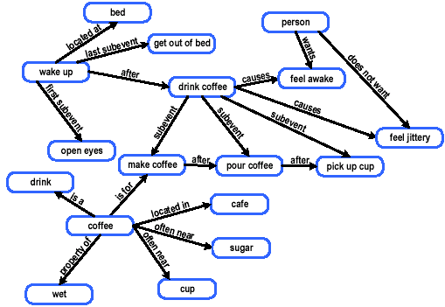
ConceptNet: Semantic Network
Fig 1. An excerpt from ConceptNet’s semantic network of commonsense knowledge

Slide 34
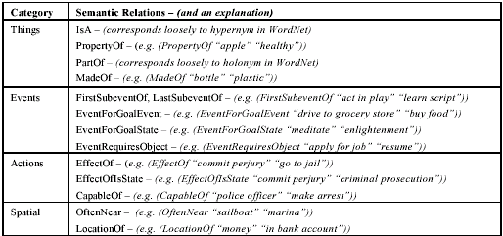
Structure of Concept
ConceptNet nodes are fragments semi-structured to conform to preferred syntactic patterns.
3 general classes:
Noun Phrases: things, places, people
Attributes: modifiers
Activity Phrases: actions and actions compounded with a NP or PP
ConceptNet edges are described by an ontology of 19 binary relations.
The syntactic and/or semantic type of the arguments are not formally constrained.
Table 2. Semantic relation types currently in ConceptNet

Slide 35
Methodology for Reasoning over Natural Language Concepts
Computing Conceptual Similarity
Flexible Inference
Context finding
Inference chaining
Conceptual analogy

Slide 36
Computing Conceptual Similarity (1/3)
The concept is decomposed into first order atomic concepts to compute its meaning.
Ex: “buy good cheese” → ”buy”, “good”, “cheese”
Each atom is situated within the conceptual frameworks of several resources.
WordNet
Longman’s Dictionary of Contempory English (LDOCE)
Beth Levin’s English Verb Classes
FrameNet

Slide 37
Computing Conceptual Similarity (2/3)
Within each resource, a similarity score is produced for each pair of corresponding atoms. (verb matching verb, etc)
The similarity score is inversely proportional to inference distance in WordNet, LDOCE, or FrameNet’s inheritance structure.
In Levin’s Verb Classes, the similarity score is proportional to the percentage of alternation classes shared.
The weighted sum of the similarity scores is produced for each atom using each of the resources.
Weight on each resource is proportional to the predictive accuracy of that resource.
Weight on a atom is proportional to the relative importance of the different atom type.

Slide 38

Computing Conceptual Similarity (3/3)
Computing conceptual similarity using lexical inferential distance is very difficult, so we can only make heuristic approximations.
Table 3. Some pairwise similarities in ConceptNet

Slide 39
Flexible Inference
One of the strengths of representing concepts in natural language is the ability to add flexibility and fuzziness to improve inference.
Inferences in semantic networks are based on graph reasoning methods like spreading activation, structure mapping, and network traversal.
Basic spreading activation
activation_score(B) = activation_score(A)*weight(edge(A,B))

Slide 40
Flexible Inference – Context Finding
Determining the context around a concept, or around the intersection of several concepts is useful.
The contextual neighborhood around a node is found by performing spreading activation from that source node.
Pairwise similarity of nodes leading to a more accurate estimation of contextual neighborhood.

Slide 41
Flexible Inference – Inference Chaining
Inference chain is a basic type of inference on a graph: traversing the graph from one node to another via some path.
A temporal chain between “buy food” and “fall asleep”:
“buy food” → “have food” → “eat food” → “feel full” → “feel sleepy” → “fall asleep”
The pairwise conceptual similarity is particularly crucial to the robustness of inference chaining.
ex: “buy steak” instead of “buy food”
(Liu, 2003) used inference chaining for affective text classification.

Slide 42
Flexible Inference – Conceptual Analogy
Structural analogy is not just a measure of semantic distance.
Ex: “wedding” is much more like “funeral” than “bride”
Structure-mapping methods are employed to generate simple conceptual analogies.
emphasize functional similarity versus temporal similarity by biasing the weights of particular semantic relations.

Slide 43
N-Gram Based Approaches
n-gram: a sequential list of n words, often used in information retrieval and language modeling to encode the likelihood that the phrase will appear in the future
N-gram Based Approaches create probabilistic models of n-grams from a given corpus of text and tag new utterances using these models.
“I don’t know what to say”
1-gram (unigram): I, don’t, know, what, to, say
2-gram (bigram): I don’t, don’t know, know what, what to, to say
3-gram (trigram): I don’t know, don’t know what, know what to, etc.
…
n-gram

Slide 44
N-Gram Motivation
Advantages
Encode not just keywords, but also word ordering, automatically
Models are not biased by hand coded lists of words, but are completely dependent on real data
Learning features of each affect type is relatively fast and easy
Human intuition is often incorrect and misses subtleties in language
Disadvantages
Long range dependencies are not captured
Dependent on having a corpus of data to train from
Sparse data for low frequency affect tags adversely affects the quality of the n-gram model

Slide 45
N-Gram Approaches
Naïve Approach
Standard n-grams only
Weighted Approach
Weight the longer n-grams higher in the stochastic model
Length Approach
Include a length-of-utterances factor, capturing the differences in utterance length between affect tags
Weights with Length Approach
Combine Weighted with Lengths
Analytical Approach
Include word repetition as a factor in the models, isolating acknowledgement utterances from other types

Slide 46
N-Gram Model Formulas
Word sequences
Chain rule of probability
Bigram approximation
N-gram approximation

Slide 47
Estimating Probabilities
Bigram:
N-gram:
N-gram conditional probabilities can be estimated from raw text based on the relative frequency of word sequences.
To have a consistent probabilistic model, append a unique start (<s>) and end (</s>) symbol to every sentence and treat these as additional words.

Slide 48
Analytical Approach
Estimate probability of each word given prior context.
P(phone | Please turn off your cell)
Number of parameters required grows exponentially with the number of words of prior context.
An N-gram model uses only N−1 words of prior context.
Unigram: P(phone)
Bigram: P(phone | cell)
Trigram: P(phone | your cell)
The Markov assumption is the presumption that the future behavior of a dynamical system only depends on its recent history. In particular, in a kth-order Markov model, the next state only depends on the k most recent states, therefore an N-gram model is a (N−1)-order Markov model.

Slide 49
N-Gram Approaches Results
6-Fold Cross Validation on the UR Marriage Corpus
Naive | Weighted | Lengths | Weights with Lengths | Analytical
66.80% | 67.43% | 64.35% | 66.02% | 66.60%
6-Fold Cross Validation on the Switchboard Corpus
Naive | Weighted | Lengths | Weights with Lengths | Analytical
68.41% | 68.77% | 69.01% | 70.08% | 61.40%

